Slide 1

Backtracking Visualizer
Group 57

Slide 2


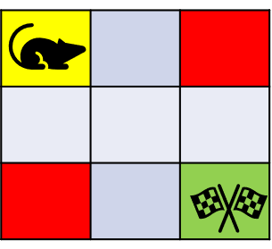
Introduction : Joe and the Landmines
Considered a customised problem
Provided resources for backtracking insights
Demonstrated how backtracking gives multiple paths
Resembles with Rat in a maze problem

